Slide 1
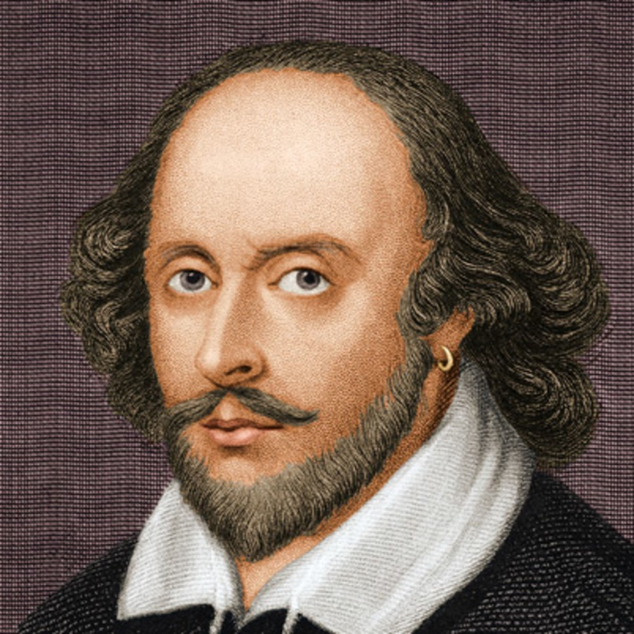
Not Marble, nor the Gilded Monuments
Sonnet 55
- William Shakespeare

Slide 2
Not marble, nor the gilded monuments
Of princes, shall outlive this powerful rhyme;
But you shall shine more bright in these contents
Than unswept stone besmear'd with sluttish time.
Notes:
Impervious (immune, unaffected) to Nature’s forces
Not marble, nor the gold-plated shrines, of princes shall outlive the power of this poetry.
Princes (wealthy people) can spend all their riches on erecting elaborate (detailed) and ornate (embellished) structures in the belief that they’ll help the world remember them. But none of them will stand the test of time like this poem.
But you will shine more bright in these verses, than on dust-covered gravestones ravaged (severely damaged) by time.
- You will live on (be remembered) in the lines of this poem longer than on any stone structure (whether chiseled into statues or engraved on tombstones) that will crumble to dust or be blackened (soiled) by time.

Slide 3
Not marble, nor the gold-plated shrines, of princes shall outlive the power of this poetry.
Princes (wealthy people) can spend all their riches on erecting elaborate (detailed) and ornate (embellished) structures in the belief that these’ll help the world remember them. But none of them will stand the test of time like this poem.
Not marble, nor the gilded monuments
Of princes, shall outlive this powerful rhyme;

Slide 4
But you shall shine more bright in these contents
Than unswept stone besmear'd with sluttish time.
But you will shine more bright in these verses, than on dust-covered gravestones ravaged (severely damaged) by time.
- You will live on (be remembered) in the lines of this poem longer than on any stone structure (whether chiseled into statues or engraved on tombstones) that will crumble to dust or be blackened (soiled) by time.

Slide 5
When wasteful war shall statues overturn,
And broils root out the work of masonry,
Nor Mars his sword, nor war’s quick fire, shall burn
The living record of your memory
Notes:
Impervious to Destruction caused by Humans
When devastating war shall overturn statues, And conflicts destroy the mason's handiwork
When unnecessary wars tear down structures in their wake and violent quarrels destroy the hard work of masons (buildings, homes)
The cause of war (Mars) nor the effects of war (fire) shall destroy, the living record of your memory (this poem).
Neither the god of war, nor the effects of war will be able to destroy this poem, which is a record of your memory.
Living record meaning, the poem is passed on from generation to generation, hence ensuring that the poem remains alive.

Slide 6
When wasteful war shall statues overturn,
And broils root out the work of masonry,
When devastating war shall overturn statues, And conflicts destroy the mason's handiwork
When unnecessary wars tear down structures in their wake and violent quarrels destroy the hard work of masons (buildings, homes)

Slide 7
The cause of war (Mars) nor the effects of war (fire) shall destroy, the living record of your memory (this poem).
Neither the Roman god of war, nor the effects of war will be able to destroy this poem, which is a record of your memory.
Living record being, the poem is passed on from generation to generation, hence ensuring that the poem remains alive.
Nor Mars his sword, nor war’s quick fire, shall burn
The living record of your memory

Slide 8
'Gainst death and all oblivious enmity
Shall you pace forth; your praise shall still find room
Even in the eyes of all posterity
That wear this world out to the ending doom.
Notes:
Against death and destruction, which render people forgotten
Shall you push onward; praise of you will always find a place,
Even in the eyes of future generations
That survive until the end of humanity.
- Despite death (which renders people forgotten) and ignorant enmity (which will be forgotten), you shall continue on. Your praises will be sung, even among all the future generations to come. Your memory will remain till the time destruction and death exhaust the world and bring it to its end.

Slide 9
'Gainst death and all-oblivious enmity
Shall you pace forth; your praise shall still find room
Against death and destruction, which render people forgotten
Shall you push onward; praise of you will always find a place
- Despite death (which renders people forgotten) and ignorant enmity (which will be forgotten), you shall continue on.

Slide 10
Even in the eyes of all posterity
That wear this world out to the ending doom.
Even in the eyes of future generations
That survive until the end of humanity.
- Your praises will be sung, even among all the future generations to come. Your memory will remain till the time destruction and death exhaust the world and bring it to its end.

Slide 11
So, till the judgment that yourself arise,
You live in this, and dwell in lovers' eyes.
Notes:
So, until you arise on Judgment Day,
You are immortalized in this poetry, and continue to live on in lovers' eyes.
- Abrahimic religions (Christianity, Islam, Judaism) believe in the Day of Judgement, the day when God passes His judgement on humanity.
- So until the Judgment Day, when you are raised from the dead, you will live on in this poetry, and in the eyes of all those who love you.

Slide 12
So, until you arise on Judgment Day,
You are immortalised in this poetry, and continue to live on in lovers' eyes.
- Until the Judgment Day, when you are raised from the dead, you will live on in this poetry, and in the eyes of all those who love you.
So, till the judgment that yourself arise,
You live in this, and dwell in lovers' eyes.

Slide 13
Theme: Immortality
-Poet argues that his friend will be immortal in the lines of his poem than if there were tangible structures erected in his honour.
- He’s confident that his sonnets will survive till the end of time, ergo his friend’s memory will stay alive for eternity.

Slide 14
Poetic Devices Used
Alliteration
Imagery

